Slide 1
CS4001- Professional Practices in IT
LEGAL FORM OF ORGANIZATIONS
Course Instructor: Anaum Hamid
Email address: anaum.hamid@nu.edu.pk

Slide 2
What is an organization
Introduction
An organization is a group of people working together in a formal way. Legal existence is must for an organization.
Examples:
schools and colleges, hospitals, banks. These all are organizations as people work in these together in an organized way and formal way.
we can work for a private company or a government department, both are organizations
Even we can set a business and make our own organization
Is a jail an organization????????

Slide 3
COMMERCIAL ORGANIZATIONS
People with particular skill set, strategy, resources, or priorities work together to turn a profit.
The law offers several different ways of setting up and operating a commercial organization.
Depending on the circumstances, the business may be operated as a sole trader, a partnership, a cooperative, or a limited company.

Slide 4
NON-COMMERCIAL BODIES
Non-profiting
Staff working as volunteers or nominal pay
Charity or Government runs it

Slide 5
Sole trader/ proprietor
A sole trader is an individual who runs their own business.
There are no legal formalities attached to becoming a sole trader; you become a sole trader simply by starting to run a business.
If the income of your business is large enough, you can get registered with customs and tax, but neither of these is necessary simply in order to become a sole trader.
73% businesses in the US are on this approach.

Slide 6
Risk for Sole trader
A sole trader is personally liable for all the debts of the business so that all the trader’s assets, including the family home, are at risk if the business fails.
Personal assets are on risks.

Slide 7
Partnership
If a group of people carry on a business with a view to making profits, and the business is not a limited company, then the law will treat them as being in a partnership.
7% businesses in the US are on this approach.
Article of partnership
Difficult to liquidate.
Nontransferable.
Partnership agreement dissolve if one of the partner is dead.
Problem factor
Share rate

Slide 8
COOPERATIVES
Cooperatives are another way in which an organization can acquire a legal existence. They are important in fields such as agriculture and enjoy a special legal status.
Stockholders- common and preferred stockholders
90% of revenue is generated by Cooperate sector in any economy.
Legal entity.
Legal power reside to sue and to be sued.
Double taxation.
No secrecy
Notes:
A cooperative is a member-owned business organization with at least five shareholders, all of whom have equal voting rights regardless of their level of involvement or investment. However, every shareholder is expected to help run the cooperative.
Advantage
It is usually inexpensive to register a cooperative.
All members and shareholders must be active in the cooperative.
Shareholders have an equal vote at general meetings regardless of their shareholding or involvement in the cooperative.
Members, other than directors, can be under 18, though these members cannot stand for office and do not have the right to vote.
Shareholders, directors, managers and employees have no responsibility for debts of the cooperative unless those debts are caused recklessly, negligently or fraudulently.
A cooperative is owned and controlled by its members, rather than its investors.
Disadvantages
As cooperatives are formed to provide a service to their members rather than a return on investment, it may be difficult to attract potential members/shareholders whose primary interest is a financial return.
There must be a minimum of five members.
There is a usually a limited distribution of surplus (profits) to members/shareholders and some cooperatives may prohibit the distribution of any surplus to members/shareholders.
Even though some shareholders may have a greater involvement or investment than others, they still only get one vote.
Active and direct involvement of members/shareholders in the cooperative.
Requires continuous cooperative education programs for members.

Slide 9
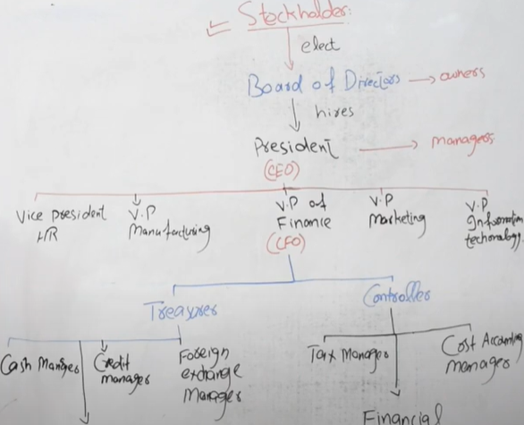

Slide 10
LIMITED COMPANIES
There are three principles that are fundamental to the concept of a limited liability company:
The company has corporate legal identity, that is, it is a legal person, completely separate from the people who work in it or the people who own it.
The ownership of the company is divided into a (usually large) number of shares. These shares can be bought and sold individually. The people who own these shares are known as the members of the company or shareholders.
In the event that the company incurs debts or other legal liabilities, the owners of the company have no obligation to pay these. The most that shareholders stand to lose is the money they paid for their shares.

Slide 11
THE CONSTITUTION OF A LIMITED COMPANY
In order for a company to be registered, it must have a constitution. This consists of two documents:
the memorandum of association and
the articles of association.

Slide 12
Memorandum
It is a document which includes :
Name of the company should be not used before and it should not contain certain words like country name or ambiguous names
The country (name or names) in which its registered office will be located
The objects of the company: This is a statement of the type of business in which the company will engage. This may simply state that its object is to carry on business as a general commercial company, without being any more specific.
A liability clause: In the case of a company limited by shares, this clause merely states that the liability of the members is limited.
The company’s authorized share capital and the number and nominal value of its shares

Slide 13
declaration of association
The memorandum will conclude with a declaration of association along the following lines:
We, the several persons whose names, addresses and descriptions are written below, are desirous of being formed into a company in pursuance of this Memorandum of Association, and we respectively agree to take the number of shares in the capital of the company set out opposite our respective names.

Slide 14
Table A
In order to simplify the setting up of companies, the Companies Act 1948 included a specimen set of articles of association, which have been regularly updated; these are known as Table A. Most companies now adopt Table A as the basis of their articles of association and specify only the way in which their articles differ from Table A.

Slide 15
DIRECTORS
The one who runs or direct the company
Has duty towards shareholders as well as company employees
Must devote himself to the companies benefits and avoid personal interest
Is liable for any wrong decision
Notes:
Directors must act in good faith and for the benefit of the company.
Suppose, for example, that you are a director of a small company that writes
software and that someone approaches you to have some software written. If
you decided that you could do this yourself in your spare time rather than
having it written by the company, you would not be considered to have acted
in good faith for the benefit of the company and you could be required to pay
the company compensation for the loss of the contract.
example, that a director with long experience of purchasing computers
who signed a contract to buy a computer system that was not suitable for the use the company intended to make of it might be ordered by a court to
pay back to the company the cost of the computer. Furthermore, directors
must take the same care as an ordinary person might be expected to take on
their own behalf.

Slide 16
SETTING UP A COMPANY
How would you set a company ?
A limited company is created by a group of people each agreeing to subscribe a certain amount of money to set up an organization to pursue some stated goal and
to register the organization as a limited company in accordance with the law
Hire an accountant and legal advisor (optional)
Buying a template company or off-the-shelf company from an agent and customize it accordingly

